Slide 1
Grammar and Machine Transforms
Zeph Grunschlag

Slide 2
Agenda
Grammar Transforms
  Right-linear grammars and regular languages
  Chomsky normal form (CNF)
  CFG ➔ PDA
    Generalized PDA’s
Context Sensitive Grammars
PDA Transforms
  Acceptance by Empty Stack
  Pure Push and Pop machines (PPP)
  PDA ➔ CFG
Notes:
For next time:
Read 1.3 and handout on minimization
Thursday, 9/20 (revised ): HW1 collected

Slide 3
Model Robustness
The class of Regular languages is very robust:
Allows multiple ways for defining languages (automaton vs. regexp)
Slight perturbations of model do not result in languages beyond previous capabilities. Eg. introducing non-determinism did not expand the class.

Slide 4
Model Robustness
The class of Context free languages is also robust, as can use either PDA’s or CFG’s to describe the languages in the class. However, it is less robust when it comes to slight perturbations of the model:
Many perturbations are okay (e.g. CNF, or acceptance by empty stack in PDA’s)
Some perturbations result in different class
  Smaller classes
    Right-linear grammars
    Deterministic PDA’s
  Larger classes
    Context Sensitive Grammars

Slide 5
Right Linear Grammars and Regular Languages
1
0
1
x
y
The DFA above can be simulated by the grammar
x → 0x | 1y
y → 0x | 1z
z → 0x | 1z | ε
z
0
1
0

Slide 6
Right Linear Grammars and Regular Languages
1
x → 0x | 1y
y → 0x | 1z
z → 0x | 1z | ε
0
1
x
y
x
10011
z
0
1
0

Slide 7
Right Linear Grammars and Regular Languages
1
x → 0x | 1y
y → 0x | 1z
z → 0x | 1z | ε
0
1
x
y
x ⇒ 1y
10011
z
0
1
0

Slide 8
Right Linear Grammars and Regular Languages
1
x → 0x | 1y
y → 0x | 1z
z → 0x | 1z | ε
0
1
x
y
x ⇒ 1y ⇒ 10x
10011
z
0
1
0

Slide 9
Right Linear Grammars and Regular Languages
1
x → 0x | 1y
y → 0x | 1z
z → 0x | 1z | ε
0
1
x
y
x ⇒ 1y ⇒ 10x ⇒ 100x
10011
z
0
1
0

Slide 10
Right Linear Grammars and Regular Languages
1
x → 0x | 1y
y → 0x | 1z
z → 0x | 1z | ε
0
1
x
y
x ⇒ 1y ⇒ 10x ⇒ 100x ⇒ 1001y
10011
z
0
1
0

Slide 11
Right Linear Grammars and Regular Languages
1
x → 0x | 1y
y → 0x | 1z
z → 0x | 1z | ε
0
1
x
y
x ⇒ 1y ⇒ 10x ⇒ 100x ⇒ 1001y
⇒ 10011z
10011
z
0
1
0

Slide 12
Right Linear Grammars and Regular Languages
1
x → 0x | 1y
y → 0x | 1z
z → 0x | 1z | ε
0
1
x
y
x ⇒ 1y ⇒ 10x ⇒ 100x ⇒ 1001y
⇒ 10011z ⇒ 10011
10011
z
0
1
0
ACCEPT!

Slide 13
Right Linear Grammars and Regular Languages
The grammar
x → 0x | 1y
y → 0x | 1z
z → 0x | 1z | ε
Is an example of a right-linear grammar.
DEF: A right-linear grammar is a CFG such that every production is of the form A → uB, or A → u where u is a terminal string, and A,B are variables.

Slide 14
Right Linear Grammars and Regular Languages
THM: If N = M = (Q, Σ, δ, q₀, F ) is an NFA then there is a right-linear grammar G (N ) which generates the same language as N.
Proof.
  Variables are the states: V = Q
  Start symbol is start state: S = q₀
  Same alphabet of terminals Σ
  A transition q₁ →a →q₂ becomes the production q₁ →aq₂
  Accept states q ∈ F define the ε-productions q → ε
Accepted paths give rise to terminating derivations and vice versa. 

Slide 15
Right Linear Grammars and Regular Languages
Q: What can you say if converting a DFA instead? What properties will the grammar have?

Slide 16
Right Linear Grammars and Regular Languages
A: Since DFA’s define unique accept paths, each accepted string must have a unique left derivation. Therefore, the generated grammar is unambiguous:
THM: The class of regular languages is equal to the class of unambiguous right-linear Context Free languages.
Proof. Above shows that all regular languages are unambiguous right-linear.
HOME EXERCISE: Show the converse. In particular, given a right-linear grammar construct an accepting GNFA for the grammar. 

Slide 17
Right Linear Grammars and Regular Languages
Q: Can every CFG be converted into a right-linear grammar?

Slide 18
Right Linear Grammars and Regular Languages
A: NO! This would mean that all context free languages are regular.
EG:
S → ε | aSb
cannot be converted because {a^{n}b^{n}} is not regular.

Slide 19
Chomsky Normal Form
Even though we can’t get every grammar into right-linear form, or in general even get rid of ambiguity, there is an especially simple form that general CFG’s can be converted into:

Slide 20
Chomsky Normal Form
Noam Chomsky came up with an especially simple type of context free grammars which is able to capture all context free languages.
Chomsky's grammatical form is particularly useful when one wants to prove certain facts about context free languages. This is because assuming a much more restrictive kind of grammar can often make it easier to prove that the generated language has whatever property you are interested in.

Slide 21
Chomsky Normal Form
DEFINITION
DEF: A CFG is said to be in Chomsky Normal Form if every rule in the grammar has one of the following forms:
  S → ε (ε for epsilon’s sake only)
  A → BC (dyadic variable productions)
  A → a (unit terminal productions)
Where S is the start variable, A,B,C are variables and a is a terminal. Thus epsilons may only appear on the right hand side of the start symbol and other RHS are either 2 variables or a single terminal.
Notes:
¹This rule is needed in case we need to accept the empty string.

Slide 22
CFG → CNF
Converting a general grammar into Chomsky Normal Form works in four steps:
Ensure that the start variable doesn't appear on the right hand side of any rule.
Remove all epsilon productions, except from start variable.
Remove unit variable productions of the form A → B where A and B are variables.
Add variables and dyadic variable rules to replace any longer non-dyadic or non-variable productions

Slide 23

CFG → CNF
Example
Let’s see how this works on the following example grammar for pal:

Slide 24
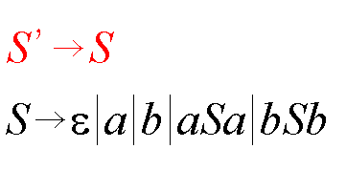
CFG → CNF
1. Start Variable
Ensure that start variable doesn't appear on the right hand side of any rule.

Slide 25
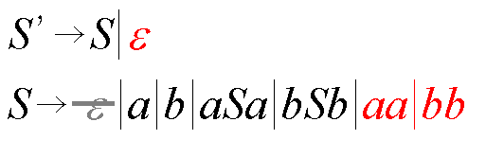
CFG → CNF
2. Remove Epsilons
Remove all epsilon productions, except from start variable.

Slide 26
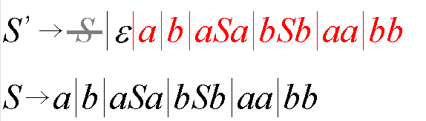
CFG → CNF
3. Remove Variable Units
Remove unit variable productions of the form A → B.

Slide 27
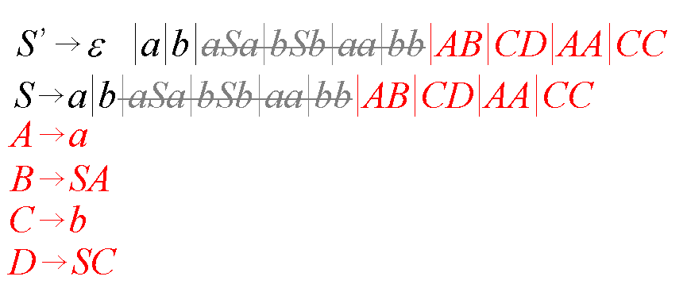
CFG → CNF
4. Longer Productions
Add variables and dyadic variable rules to replace any longer productions.

Slide 28
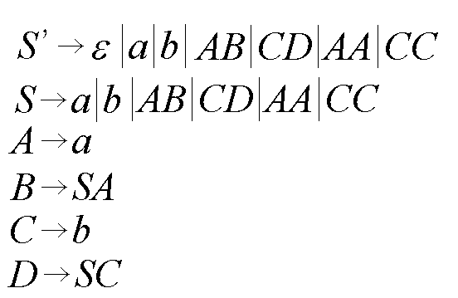
CFG → CNF
Result

Slide 29
CFG → CNF
Using JavaCFG
JavaCFG allows for the automatic conversion of Grammars into Chomsky normal form. Lets see what happens to pal.cfg under the following:
java CFG pal.cfg –removeEpsilons
Results in: pal_noeps.cfg
java CFG pal_noeps.cfg -removeUnits
Results in: pal_noeps_nounits.cfg
java CFG pal_noeps_nounits.cfg -makeCNF
Results in: pal_noeps_nounits_cnf.cfg
See the pseudocode for the conversion process.
Notes:
Under Windows, the carriage return is lost. You can replace by Windows compatible carriage
Returns without affecting the performance of JavaCFG.

Slide 30
CFG → PDA
Right linear grammars convert into NFA’s. In general, CFG’s can be converted into PDA’s.
In “NFA → REX” it was useful to consider GNFA’s as a middle stage. Similarly, it’s useful to consider Generalized PDA’s here.

Slide 31
Generalized PDA’s
A Generalized PDA (GPDA) is like a PDA, except it allows the top stack symbol to be replace by a whole string, not just a single character or the empty string. It is easy to convert a GPDA’s back to PDA’s by changing each compound push into a sequence of simple pushes.

Slide 32
CFG → PDA
Example
Convert the grammar
S → ε |a | b | aSa | bSb
into a PDA. The idea is to simulate grammatical derivations within the PDA.

Slide 33
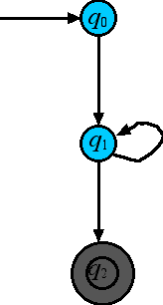
CFG → PDA
Example
Always start with three states for the GPDA:
S → ε |a | b | aSa | bSb

Slide 34
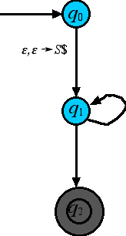
CFG → PDA
Example
First transition pushes S$ so we can tell when the stack is empty ($), and also start the simulation (S).
S → ε |a | b | aSa | bSb

Slide 35
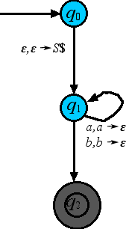
CFG → PDA
Example
Allow for the reading/popping of terminals so we can read any generated terminal strings.
S → ε |a | b | aSa | bSb

Slide 36
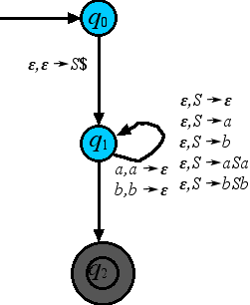
CFG → PDA
Example
Simulate all the productions by adding non-read transitions.
S → ε |a | b | aSa | bSb

Slide 37
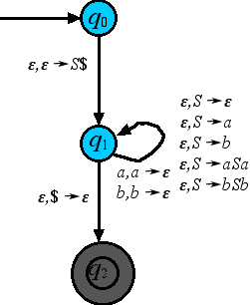
CFG → PDA
Example
Pop the $ off to accept when the stack is empty (must have expired the variables and have read all terminals)
S → ε |a | b | aSa | bSb

Slide 38
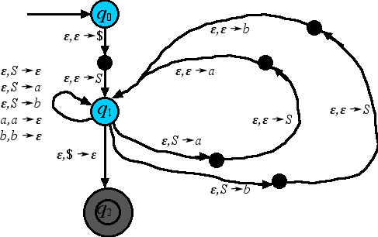
CFG → PDA
Example
Convert GPDA into a regular PDA by breaking up string pushes.
S → ε |a | b | aSa | bSb

Slide 39

CFG → PDA
Example
bbaabb
S → ε |a | b | aSa | bSb

Slide 40
CFG → PDA
Example
bbaabb
S → ε |a | b | aSa | bSb
$

Slide 41
CFG → PDA
Example
bbaabb
S → ε |a | b | aSa | bSb
S | $

Slide 42
CFG → PDA
Example
bbaabb
S → ε |a | b | aSa | bSb
b | $

Slide 43
CFG → PDA
Example
bbaabb
S → ε |a | b | aSa | bSb
S | b | $

Slide 44
CFG → PDA
Example
bbaabb
S → ε |a | b | aSa | bSb
b | S | b | $

Slide 45
CFG → PDA
Example
bbaabb
S → ε |a | b | aSa | bSb
S | b | $

Slide 46
CFG → PDA
Example
bbaabb
S → ε |a | b | aSa | bSb
b | b | $

Slide 47
CFG → PDA
Example
bbaabb
S → ε |a | b | aSa | bSb
S | b | b | $

Slide 48
CFG → PDA
Example
bbaabb
S → ε |a | b | aSa | bSb
b | S | b | b | $

Slide 49
CFG → PDA
Example
bbaabb
S → ε |a | b | aSa | bSb
S | b | b | $

Slide 50
CFG → PDA
Example
bbaabb
S → ε |a | b | aSa | bSb
a | b | b | $

Slide 51
CFG → PDA
Example
bbaabb
S → ε |a | b | aSa | bSb
S | a | b | b | $

Slide 52
CFG → PDA
Example
bbaabb
S → ε |a | b | aSa | bSb
a | S | a | b | b | $

Slide 53
CFG → PDA
Example
bbaabb
S → ε |a | b | aSa | bSb
S | a | b | b | $

Slide 54
CFG → PDA
Example
bbaabb
S → ε |a | b | aSa | bSb
a | b | b | $

Slide 55
CFG → PDA
Example
bbaabb
S → ε |a | b | aSa | bSb
b | b | $

Slide 56
CFG → PDA
Example
bbaabb
S → ε |a | b | aSa | bSb
b | $

Slide 57
CFG → PDA
Example
bbaabb
S → ε |a | b | aSa | bSb
$

Slide 58
CFG → PDA
Example
bbaabb
accept!
S → ε |a | b | aSa | bSb

Slide 59
CFG → PDA
Intuitively, every left-most derivation can be simulated in the PDA as follows:
Put S on the stack
Change variable on top of stack in accordance with next production
Read input to get to next variable on stack
If stack empty accept. Else, go to no. 2
On the other hand, every accepting computation must have gone through the steps above and so corresponds to a left-most derivation in G.
This shows that the PDA constructed accepts the same language as the original grammar.

Slide 60
Context Sensitive Grammars
An even more general form of grammars exists. In general, a non-context free grammar is one in which whole mixed variable/terminal substrings are replaced at a time. For example with Σ = {a,b,c} consider:
For technical reasons, when length of LHS always ≤ length of RHS, these general grammars are called context sensitive.
S → ε | ASBC
A → a
CB → BC
aB → ab
bB → bb
bC → bc
cC → cc

Slide 61
Blackboard Exercise
Find the language generated by:
S → ε | ASBC
A → a
CB → BC
aB → ab
bB → bb
bC → bc
cC → cc

Slide 62
Blackboard Exercise
Answer is {a^{n}b^{n}c^{n}}. Next time we’ll see that this language is not context free. Thus perturbing context free-ness by allowing context sensitive productions expands the class.

Slide 63
PDA → CFG
To convert PDA’s to CFG’s we’ll need to simulate the stack inside the productions. Thus the simpler the stack actions, the better the chance of doing this. Furthermore, any other restrictions will help in convergting. Therefore, it’s useful to first convert a given PDA to as simple a PDA as possible:

Slide 64
PPP → CFG
Simplifying Assumption
PPP assumption: The stack only allows Pure Pushes and Pops.
Unique accept state.
Empty Stack: The only accepted strings arrive at the accept state only when their stack is empty
Let’s convert a typical example to this form.

Slide 65
Simplifying the PDA
Original Example
a , X→Y
a, ε→ε
ε , ε→$
b, ε→X
ε , $→ε

Slide 66
Simplifying the PDA
1. Pure Push Pop
1A) Make sure the stack is always active
by replacing inactive stack moves by a
push followed by
immediate pop of a
dummy symbol.
a , X→Y
a, ε→ε
ε , ε→$
b, ε→X
ε , $→ε

Slide 67
Simplifying the PDA
1. Pure Push Pop
1A) Make sure the stack is always active
by replacing inactive stack moves by a
push followed by
immediate pop of a
new dummy symbol.
a, ε→D
ε,D→ε
a , X→Y
ε , ε→$
b, ε→X
ε , $→ε

Slide 68
Simplifying the PDA
1. Pure Push Pop
1B) Any move that replaces the top letter
on the stack should be
changed into a pop
followed by a push.
a, ε→D
a , X→Y
ε,D→ε
ε , ε→$
b, ε→X
ε , $→ε

Slide 69
Simplifying the PDA
1. Pure Push Pop
1B) Any move that replaces the top letter
on the stack should be
changed into a pop
followed by a push.
a , X→ε
a, ε→D
ε , ε→Y
ε,D→ε
ε , ε→$
b, ε→X
ε , $→ε

Slide 70
Simplifying the PDA
2. Unique Accept State
Turn off original accept states and
connect to a new accept
state (don’t forget that can’t
ignore the stack).
a , X→ε
a, ε→D
ε , ε→Y
ε,D→ε
ε , ε→$
b, ε→X
ε , $→ε

Slide 71
Simplifying the PDA
2. Unique Accept State
Turn off original accept states and
connect to a new accept
state (don’t forget that can’t
ignore the stack).
ε,D→ε
a , X→ε
a, ε→D
ε,ε→D
ε , ε→Y
ε,D→ε
ε , ε→$
b, ε→X
ε , $→ε

Slide 72
Simplifying the PDA
3. Empty Stack
Make sure the stack empties it’s content by adding a new dummy empty stack symbol and new start/accept states.
ε,D→ε
a , X→ε
a, ε→D
ε,ε→D
ε , ε→Y
ε,D→ε
ε , ε→$
b, ε→X
ε , $→ε

Slide 73
Simplifying the PDA
3. Empty Stack
Make sure the stack empties it’s content by adding a new dummy empty stack symbol and new start/accept states.
ε , ¢→ε
ε,ε→D
ε,D→ε
ε,$→ε
ε,X→ε
ε,Y→ε
ε,D→ε
ε , ε→¢
a , X→ε
a, ε→D
ε,ε→D
ε , ε→Y
ε,D→ε
ε , ε→$
b, ε→X
ε , $→ε

Slide 74
Simplifying the PDA
3. Empty Stack
Make sure the stack empties it’s content by adding a new dummy empty stack symbol and new start/accept states.
ε , ¢→ε
ε,ε→D
ε,D→ε
ε,$→ε
ε,X→ε ε,Y→ε
ε,D→ε
ε , ε→¢
a , X→ε
a, ε→D
ε,ε→D
ε , ε→Y
ε,D→ε
ε , ε→$
b, ε→X
ε , $→ε

Slide 75
PDA → CFG
Once a PDA has been converted into the restricted form, we can convert to a CFG through a standard procedure.
Now that accepted paths start and end with empty stack, it is possible to consider any such path, between any two states and recursively generate all such paths. This recursive relationship between paths will give rise to the recursion at the heart of the representative context free grammar.

Slide 76
PDA → CFG
Recursing on Paths
Notation: given two states q,r in the PDA, and a string x in the given input alphabet, the notation
q-x→r
will mean that it is possible to get from q to r reading the input x, starting and ending on empty stack:
Q: Express acceptance in terms of this notation.
input
x
q
r
a | a | a | $

Slide 77
PDA → CFG
Recursing on Paths
A: For our restricted PDA’s with unique accept state q_{F} a string x is accepted iff q₀-x→q_{F}
Therefore, accepted strings generated if can generate all “triples” satisfying q-x→r. This is done recursively on path length:
Base-Rule: Empty string can always be considered as getting you from q to q without doing any thing to the stack, since nothing was read:
q-ε→q

Slide 78
PDA → CFG
Recursing on Paths
Transitive Recursion Rule: If can get from q to r without affecting stack, and also from r to s then combine paths to get a path from q to r. I.E:
q-x→r and r-y→s implies q-xy→s
x
y
q
r
s
xy

Slide 79
PDA → CFG
Recursing on Paths
Push-Pop Recursion Rule: If can get from q to r without affecting stack, and push a symbol X from p to q which gets popped from q to r, then can go from p to r on empty stack:
q-x→r and (q,X)∈δ(p, a, ε) and (s, ε)∈δ(r,b, X) implies p-axb→s
X
x
X
q
r
b, X→ε
a, ε→X
p
s
axb
Notes:
This works because q-x→r implies that first move from q must have been a push, since there was nothing to pop. Thus, putting X on the st

Slide 80
PDA → CFG
Recursing on Paths
LEMMA: Any triple q-x→r must have been generated inductively by one of the rules (1), (2) or (3) above.
Proof. Use induction on the length n of the path for
q-x→r.
Base Case n = 0: x must be the empty string and such paths generated by rule (1).
Induction n > 0: Follow the accepted path starting from the empty stack. There are two possible situations:
Somewhere in the middle, the stack emptied.
The stack was never empty until very end.

Slide 81
PDA → CFG
Recursing on Paths
Case I. Somewhere in the middle, say at state s, the stack emptied: Then can break up path into two parts, each with its own read input, and each starting and ending with empty stack. I.e. break x up as x = uv such that q-u→s and s-v→r. This is just rule (2).

Slide 82
PDA → CFG
Recursing on Paths
Case II. The stack was never empty until very end. Therefore, first move must have been a push (nothing to pop) of a symbol X which was not popped off until last move. Let s be the state arrived at after the first move, and t be the state right before last move. Then one can arrive from s to t on empty stack and reading some string u. Furthermore, (s,X)∈δ(p,a,ε), (r,ε)∈δ(p,b,X) and x = aub. This is exactly the situation where Rule (3) applies.
This completes the proof. 

Slide 83
PDA → CFG
The Grammar
The three rules for generating all such paths give a grammar to generate all labels of such paths. The grammar will have variables called A_{qr} which will generate all strings x for which q-x→r.
Q: Under this assumption, what should our start variable be?

Slide 84
PDA → CFG
The Grammar –Symbols
A: S = A_{q0qF} This follows from the fact that accepted strings are exactly those for which q₀-x→q_{F} holds.
In addition to this start variable, the other variables in V are all A_{qr} for which there is a path going from q to r which starts and ends on empty stack.¹
The terminal set Σ is the input alphabet of the PDA.
Notes:
¹Notice that Sipser doesn’t require the extra condition that there be a path from q to r which starts and ends on empty stack. However, those pairs q,r for which no such path exists will create useless variables A_{qr} which will end up cluttering the grammar and make the construction extremely ugly, even on the simplest PDA’s. On the other hand, it is not obvious how one would even determine a-priori which of the pairs don’t have such paths, which explains why Sipser probably didn’t include this condition. Later in the course, we will see that it’s possible to determine which are the useless pairs, but ironically, the proof involves first converting the PDA into a CFG…

Slide 85
PDA → CFG
The Grammar –Rules
The rules are exactly rules (1), (2) and (3):
Add a production A_{qq}→ε for each state q in the PDA.
Add a production A_{pr}→ A_{pq} A_{qr} for all p,q,r when A_{pr} , A_{pq} and A_{qr} are all in V.
Add a production A_{ps}→ aA_{qr}b for all p,s,q,r when A_{ps} and A_{qr} are in V, and when transitions (q,X)∈δ(p,a,ε), (s,ε)∈δ(r,b,X) for the same tape symbol X exist in the PDA.

Slide 86
PDA → CFG
Example
Here’s an example of a PDA which is already in the correct form:
Q: What’s the accepted language?
(, ε →X
), X→ε
ε , ε→$
ε , $→ε
q
r
s

Slide 87
PDA → CFG
Example
A: “CNP” = correctly nested parentheses. The number of X’s on the stack reflects how deep the current nesting is.
Q: What are the variables for the equivalent grammar? Start variable?
(, ε →X
), X→ε
ε , ε→$
ε , $→ε
q
r
s

Slide 88
PDA → CFG
Example
A: V = {A_{qs} , A_{qq} , A_{rr} , A_{ss}}, S = A_{qs}
Don’t need A_{rq} , A_{sq} , A_{sr} because wrong direction. Don’t need A_{qr} or A_{rs} because can’t add or revome $ while at r.
Q: What productions come from rule (1)?
(, ε →X
), X→ε
ε , ε→$
ε , $→ε
q
r
s

Slide 89
PDA → CFG
Example
A: A_{qq} →ε , A_{rr} →ε , A_{ss} →ε
Q: What productions come from rule (2)?
(, ε →X
), X→ε
ε , ε→$
ε , $→ε
q
r
s

Slide 90
PDA → CFG
Example
A: A_{qs} → A_{qq} A_{qs} | A_{qs} A_{ss}
A_{qq} → A_{qq} A_{qq}
A_{rr} → A_{rr} A_{rr}
A_{ss} → A_{ss} A_{ss}
Q: What productions come from rule (3)?
(, ε →X
), X→ε
ε , ε→$
ε , $→ε
q
r
s

Slide 91
PDA → CFG
Example
A: A_{qs} → A_{rr} , A_{rr} → (A_{rr})
Therefore grammar is given by¹:
A_{qs} → A_{rr} | A_{qq} A_{qs} | A_{qs} A_{ss}
A_{rr} → ε | A_{rr} A_{rr} | (A_{rr})
A_{qq} →ε | A_{qq} A_{qq}
A_{ss} → ε | A_{ss} A_{ss}
Q: Any obvious simplifications?
(, ε →X
), X→ε
ε , ε→$
ε , $→ε
q
r
s
Notes:
¹This is the “official” answer. However, obvious simplifications ought still be applied.

Slide 92
PDA → CFG
Example
A: Apparently A_{qq} and A_{ss} are purely self-referential, so the only way to terminate them is eventually by erasing. So can remove the variables A_{qq} , A_{ss} as long as replace them by ε:
A_{qs} → A_{rr} | A_{qq} A_{qs} | A_{qs} A_{ss}
A_{rr} → ε | A_{rr} A_{rr} | (A_{rr})
A_{qq} →ε | A_{qq} A_{qq}
A_{ss} → ε | A_{ss} A_{ss}
Becomes:
A_{qs} → A_{rr} | A_{qs}
A_{rr} → ε | A_{rr} A_{rr} | (A_{rr})

Slide 93
PDA → CFG
Example
A_{qs} → A_{rr} | A_{qs}
A_{rr} → ε | A_{rr} A_{rr} | (A_{rr})
Rename variables to get:
S → T | S
T → ε | TT | (T )
Final answer (S isn’t needed as its whole purpose is to get you to T ):
T → ε | TT | (T )

